Slide 1
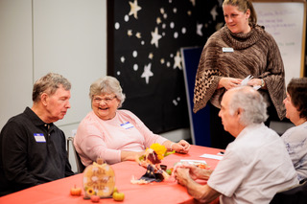
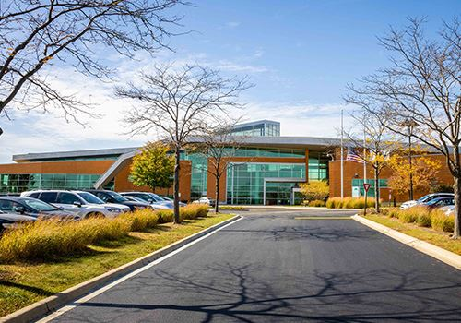
MEMORY CAFÉ
Sponsored by Dementia Friendly Naperville and
the Naperville Senior Task Force
Join us for a social gathering of individuals living with dementia and their care partners. We offer a place where both care partner and care recipient can socialize together and connect with others in similar situations. Activities at this FREE event vary including education, music, games and arts.
Memory Cafés are held
on the second Tuesday
of every month
2:00 pm to 3:30 pm
Location: Naperville Public Library, 95th Street Branch, 3015 Cedar Glade Dr. Naperville
. Register online at www.naperville-lib.org Walk-ins are welcome.
For more information, call Lisa Kirchner at (630) 710-7502.

